Slide 1

Engineering Processes

Slide 2
Business Process vs Engineering Process vs System (or Pipeline) Process
Note the three different processes:
Analyze Business Process to understand how the system of interest would support the Business meet the larger organization's objectives
Engineering Process to help guide the development and maintenance of system-of-interest
System often execute data extractions, data transformations, data serving as a pipeline; pipeline can be viewed as a system’s process
Notes:
Business processes use systems. Systems are developed and managed with engineering processes. The systems are built to execute processes to support business processes. In data engineering, pipelines are a more specific term for the type system developed in manipulating data for machine learning needs.

Slide 3

Engineering Processes
Often employ structured processes to
Support verification and validation
Support coordination of changes
Reduce risks of bugs, avoiding costly consequences
Structured processes often required when
Larger projects with larger teams
Consequences are serious or grave
Dynamic environments

Slide 4
Engineering Processes
System
Raw data
Data to actors
Interface: part of the system that defines how the system exposes itself for interactions with external actors (systems)
The border of the system
Some processes require an Interface Control Document (ICD) to capture these requirements,
Example Template

Slide 5
Engineering Processes
System
Raw data
Data to actors
Implementation: part of the system that fulfills and executes the interactions
The inner-part of the system

Slide 6
Engineering Processes
System
Raw data
Data to actors
Component or Sub-System: an isolatable part of the larger system
Often consider Components having distinct interfaces and implementations as well!
Implementation design strongly focused on what components to incorporate and how they
Integrate with one-another

Slide 7
Engineering Processes
System
System
System
System
System
Raw data
Data to actors
The Systems are generally not isolated!!
Sometimes the data flows in multiple directions and to multiple actors

Slide 8
Engineering Processes
May entail the following stages or steps:
Requirements Analysis
Feasibility
Concept Generation
Preliminary Design
Detailed Design
Operations Planning
Often these stages are revisited throughout development and execution of system/pipeline as new requirements emerge and other requirements are removed

Slide 9
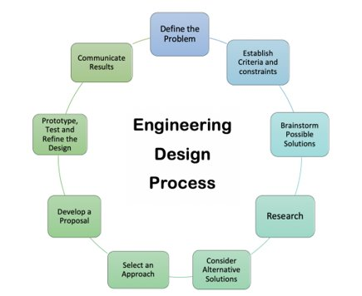
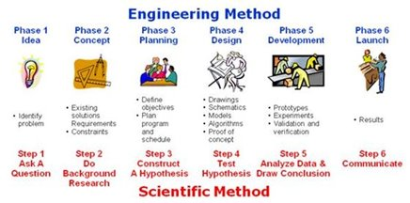
Engineering Processes
Employ Scientific Methods
Often Iterative
Notes:
Multiple formal and informal processes proposed to support system/pipeline development.

Slide 10
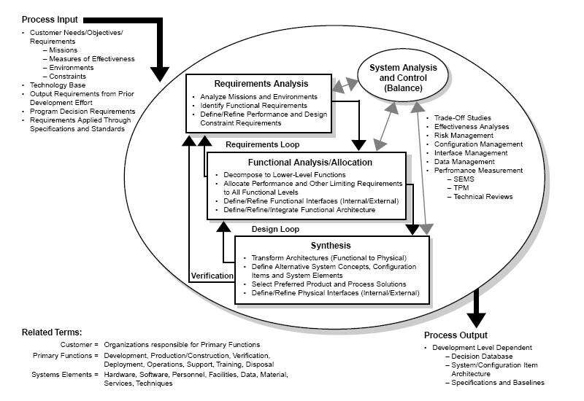
Image extracted from Systems Engineering Fundamentals. Defense Acquisition University Press
More complex systems employ more comprehensive engineering processes!
Notes:
Systems that are very important or that must address special considers such as 24/7 operations, may require formal processes to adequately address risks.

Slide 11
Engineering Processes
Waterfall Method
Incorporates sequential steps
Larger upfront design steps
Development only starts after majority of design completes
Better when requirements are likely not to change and when the technology and algorithms to be used are mature and used in a standard way
Sometimes oriented into a V-shape to enforce and to show validation links

Slide 12
Engineering Processes
Kanban Method
More iterative in nature, incorporating small changes at a time
Use Kanban board
Better when existing system in place or requirements are in a state of flux
https://en.wikipedia.org/wiki/Kanban_(development)

Slide 13
Engineering Processes
Agile Methods
Specialized version of Kanban, incorporating structured iterations (sprints)
Often 15-minute daily meetings, two-week long sprints
https://www.scrum.org/learning-series/what-is-scrum

Slide 14
Engineering Processes
Simplified process suggestion for smaller data engineering pipelines and systems
Assess Problem and Objectives
Interface Design
Focused on interactions, and the data in the interactions, between external actors
Implementation Design
Choosing technology, algorithms, and building blocks to fulfill interactions specified by interface design
Development
Testing
Maintenance

Slide 15
Engineering Processes
1. Assess Problem and Objectives
2. Interface Design
6. Operations Management
Integration Tests
3. Implementation Design
Unit Tests
5. Component Testing
4. Development

Slide 16
Engineering Processes
1. Assess Problem and Objectives
Orient
Observe
2. Interface Design
6. Operations Management
Integration Tests
3. Implementation Design
Unit Tests
5. Testing
4. Development
Decide
Act
https://en.wikipedia.org/wiki/OODA_loop

Slide 17
Engineering Processes
Agile approaches generally track requirements and use cases with tasks
Use Cases are can be documented as user-story tasks
Requirements are can be documented as issue tasks
JIRA https://www.atlassian.com/agile/project-management

Slide 18
Engineering Process Recap
How do engineering processes help create and maintain scalable, reliable data-intensive capabilities?
How do business processes, engineering processes, and systems/pipelines affect each-other?

